Slide 1

Revolutionizing Health Insurance Claim Processes with Blockchain
Guided by: Dr. Wei-Kuang Huang
ManMEET Kaur
Shubham Patil
Vishwadish desale

Slide 2
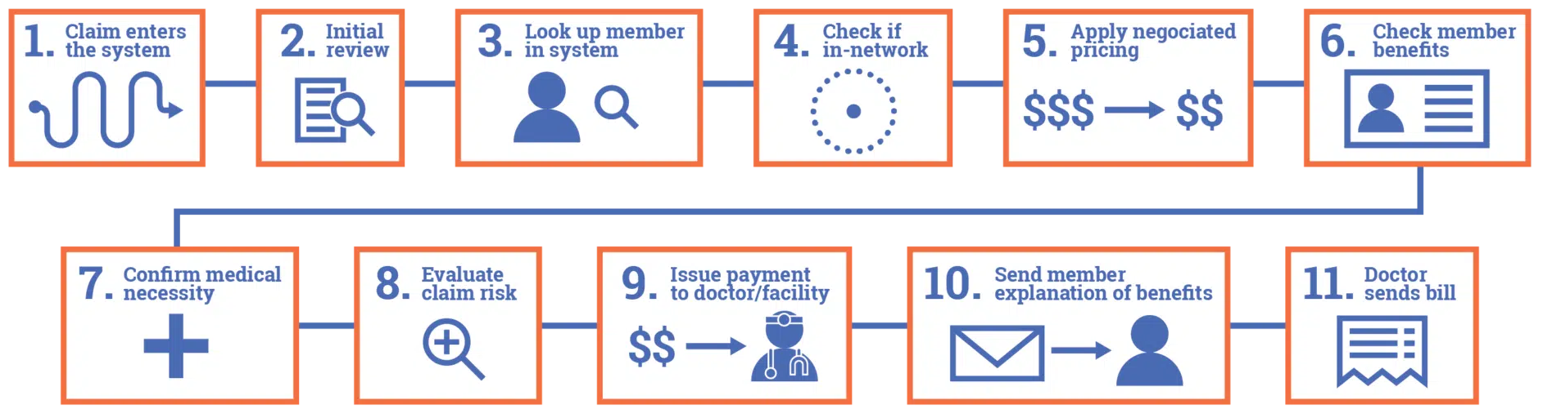
Traditional health insurance claim
Claim Submission
Review for appropriate filing period
Check for active plan
Service provider under plan
Apply discounted price
Verify members benefits
Verify medical necessity
Evaluate claim risk
Issue payment to service provider
EOB to member-not a bill
Bill aligns with EOB

Slide 3

Business Issues

Slide 4



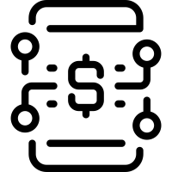


Verification of Identity & Insurance Coverage
Verification takes 7-10 days
Insurance Coverage takes 20-30min
Provision of Medical Records
Maintaining & Sharing Records
Provide medical history
Claim Submission
Manual Claims
Errors
Delays
Documentation
Costs
Adjudication and Payment
Multiple parties involved
Errors in Calculations
Cannot Verify Bills
Data Breaches
Privacy Issues
Financial Losses
Claim Processing
Slow Processing
Intermediaries Involved
Manual Reviews
Late Payments

Slide 5
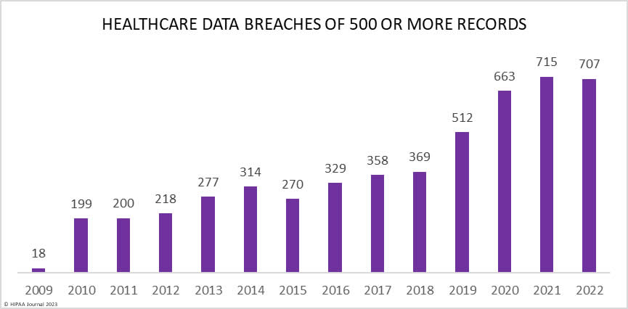
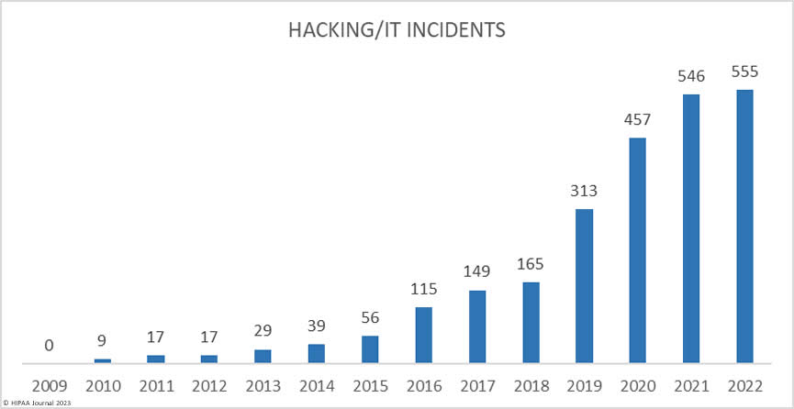
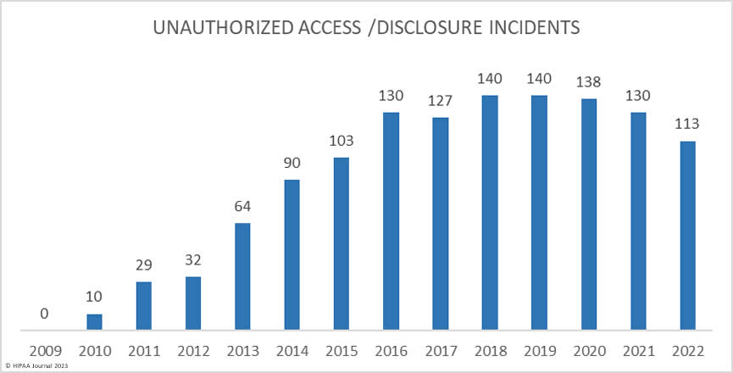
Statistics on Health Record Breaches from 2009-2022
Source: HIPAA Journal

Slide 6
Financial losses due to Health Record Breaches
Our healthcare data breach statistics clearly show there has been an upward trend in data breaches over the past 14 years, with 2021 seeing more data breaches reported than any other year. Between 2009 and 2022, 5,150 healthcare data breaches of 500 or more records have been reported to the HHS’ Office for Civil Rights.
This breaches have resulted in the exposure or impermissible disclosure of 382,262,109 healthcare records. That equates to more than 1.2x the population of the United States.
Moreover, data breaches leads to massive financial losses for Insurance firms and regulatory bodies keep track of data records to protect user’s sensitive data .
In 2018, the largest ever financial penalty for HIPAA violations was paid by Anthem Inc to resolve potential violations of the HIPAA Security Rule. It was 78.8 million record data breach in 2015. Anthem paid $16 million to settle the case.
In 2020, Premera Blue Cross settled potential violations of the HIPAA Rules and paid a $6.8 million penalty to resolve its 2015 data breach of almost 10.5 million individuals.
Source: HIPAA Journal

Slide 7
Case Studies of Successful Implementation of Blockchain in Health Insurance Claim Process
UnitedHealth Group | ProximaX | Aetna
UnitedHealth Group collaborated with Quest Diagnostics, Humana, MultiPlan, and Optum to create a blockchain- enabled platform that streamlines the process of updating healthcare provider directories. The project aimed to eliminate the need for manual provider directory updates, which are time- consuming and error- prone. | ProximaX is a blockchain- based platform that enables secure and fast health claims processing and management. The platform enables automated, auditable, and transparent claims processing, which, in turn, leads to reduced operational costs and real- time adjudication of claims. | Aetna collaborated with SmartHealthIT to create a blockchain-powered network for secure exchange of healthcare data. The project aimed to improve data privacy, reduce administrative costs, and enhance the accuracy of healthcare information.

Slide 8
Proposed
Solution

Slide 9



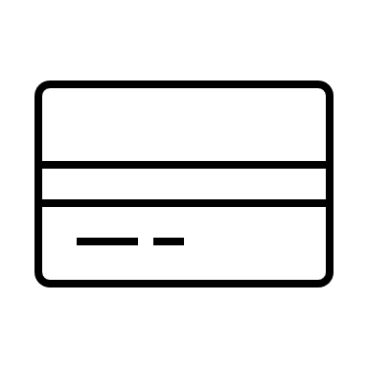



Streamlining Health Insurance Claims with Blockchain Technology
Patient Enrolment
Medical Labs
Dock Wallet
Decentralized ID
User
Credentials
Hospitals
Insurance Companies
Establishing Secure Digital Identities with Dock Wallet
The traditional enrollment process in healthcare often involves a tedious and paperwork-heavy approach, leading to data vulnerabilities and administrative bottlenecks.
Patients can create their secure digital identities using Dock Wallet during the onboarding process. This identity includes their personal information and Electronic Health Records, which is securely stored on the blockchain.
The use of Dock Wallet not only enhances privacy and data security but also streamlines the onboarding process for patients, marking a significant departure from traditional methods.

Slide 10



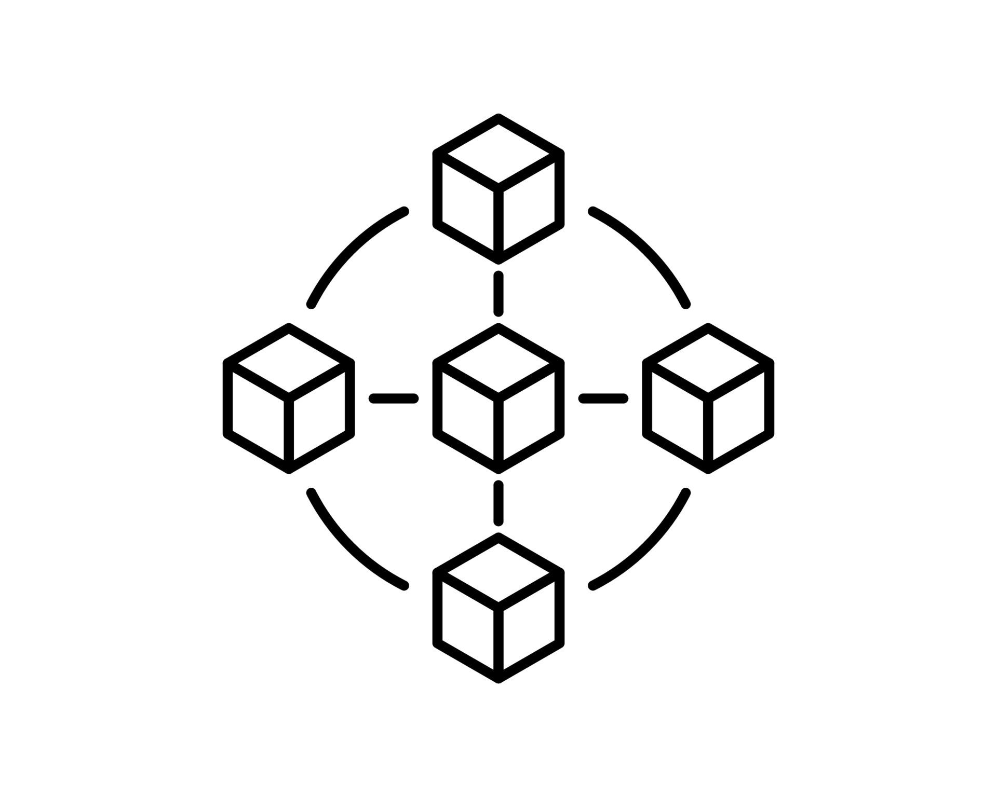
Recording Comprehensive Health Data
EHR Systems: Healthcare providers use Electronic Health Records systems to manage patient information electronically.
Real-time Data: Data is captured and transmitted in real-time, enhancing accuracy and completeness.
Streamlined Exchange: Standardizing data exchange, making healthcare data universally accessible for efficient claim process.
Ensuring Data Integrity
Verifiable Credential
Dock Wallet
Users
Hashing Algorithm
Platform Ledger
This dual-storage approach aligns with the principles of self-sovereign identity (SSI), where individuals have control over their personal data, and blockchain technology ensures data integrity and transparency. It also enhances security and privacy by reducing the risk of data breaches and unauthorized access.

Slide 11









Claim Submission by the insured
Users use their DID credentials to sign into our application
Dedicated section within the dashboard for submitting and managing insurance claims.
Develop a digital claim form that collects all necessary information from the user. This form should include fields for personal information, policy details, medical records, and supporting documents.
Smart contract compares the bills from user and hospital ledger.
Calculate the number and of claims covered in the insurance.
Generate the final statement to process the payment.
Request Bills & EHR
Claim Request
Insurance Company
Patient
Provider
Result (EOB)
Insured Amount
Verify Bills &EHR

Slide 12

Automated Smart Contract Workflow
Claim Initiation
Identity Verification
Insurance Validation
Eligibility for Coverage
Notification to all parties
Verify & Compare Medical Bills
Explanation of Benefits (EOB) Communication
Final Statement of Insurance Claimed

Slide 13
Advantages of Smart Contract Automation
Data Validation
Smart contract validates user information aligns with insurance terms & medical records
Data Validation
Smart contract validates user information aligns with insurance terms & medical records
Data Validation
Smart contract validates user information aligns with insurance terms & medical records
Discrepancies & Resolution
In cases of errors, the smart contract triggers notifications for manual review and resolution.
Automation Rules
Predefined rules in smart contract based on insurance policies & regulatory requirements
Discrepancies & Resolution
In cases of errors, the smart contract triggers notifications for manual review and resolution.
Discrepancies & Resolution
In cases of errors, the smart contract triggers notifications for manual review and resolution.
Transparency
Using smart contract & blockchain's features, enhanced transparency and enabling auditability
Transparency
Using smart contract & blockchain's features, enhanced transparency and enabling auditability

Slide 14
Software Layer Stack
Dock Wallet (Create Digital ID)
Access Layer
Platform Interface
Application Layer
Select Insurance Plan
Upload Health History Records
Smart Contract
Identity Verification
Validity of Insurance
Eligibility for Coverage
Verify Medical Bills
Protocol Layer
Platform Ledger (Storage)
Health Care Provider Ledger (HCP Storage)
Enterprise Blockchain
Blockchain Layer
Doctors & Medical Labs
Insurance Companies

Slide 15






Blockchain Architecture
Dock Wallet
Claim Insurance
User
Platform Ledger
Create Digital Identity
Select Insurance Plan
Upload EHR
Decentralized ID Insurance & Coverage details
EHR
Smart Contract
/
Identity Verification
Validity of Insurance
Eligibility for Coverage
Verify Medical Bills
Bills Verification result
Final Statement
Health Care Provider
(Doctors, Labs, Hospitals)
HCP Ledger
Lab Tests Reports
Hospital & Medical Bills
EMR

Slide 16
Comparison between Traditional Process and Blockchain-Enabled Process
Traditional Process | Blockchain-Enabled Process
The traditional process is slow and paper-based. It involves considerable amounts of paperwork, data discrepancies, and human errors. This, in turn, leads to claim rejections, delayed payments, and extensive phone calls. Slow Paper-based High human error rate Delayed payments and claim rejections | The blockchain-enabled process enhances efficiency, transparency, and security. Claim submissions are automated, and processing takes place in real-time. This results in quick adjudication of claims and eliminates human errors and fraudulent activities. Quick resolution of claims Automated claim submissions Real-time processing

Slide 17
Benefits of Using Blockchain in Health Insurance Claims
Enhanced Security and Fraud Prevention-
Blockchain provides a tamper-proof and secure system of shared information, which eliminates the risk of costly claim denials, data breaches, and fraudulent activities.
Improved Efficiency and Transparency-
Blockchain enables seamless communication of insurance information, automated decision-making, and real-time updates on claims processing, making health insurance processes faster and more transparent.
Streamlined Claims Management Process-
Blockchain-enabled claims management systems reduce the need for intermediaries, accelerate claims processing, and reduce operational costs. This, in turn, leads to quick adjudication of claims and improved customer satisfaction.

Slide 18






Critical factors needed for success
Regulatory Compliance
Interoperability: Ensuring compatibility and seamless communication between different systems
Education and Training
Feedback Loop
Continuous Improvements

Slide 19
Conclusion
Challenges | Solution
Ample of documentation and sharing of medical health records across the entities involved. Time and cost required for health insurance verification, claim and reimbursement process. Security and data privacy issues. Billing errors lead to delay in payment processing. | Dock wallet enable users to create digital identity for verification and medical records can be shared with user consent. Automation using smart contracts makes this process faster and eliminates the intermediaries required for insurance verification and claim. Data stored in ledger is secure and immutable. This feature of blockchain helps to deal with security and data privacy issues. Medical bills are compared and verified by smart contract. It resolves billing errors and time required to calculate insurance payment.

Slide 20
Thank you

